Slide 1
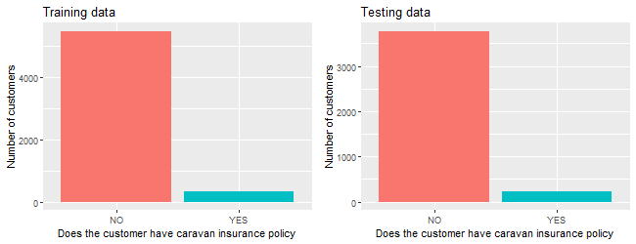
Qualification of the problem
GOAL: TO PREDICT WHO WOULD BE INTERESTED IN BUYING A CARAVAN INSURANCE POLICY AND EXPLAIN WHY?
WHY IS THE ISSUE RELEVANT:
It’s important for every insurance company to understand their customers and be able to build a customer-centric marketing model
If Insurance company could predict the behavior of their customers, they can optimize marketing strategies for maximal cost-efficiency
DATA:
The raw data was downloaded from The Insurance Company Benchmark – KDD Cup
86 predictor variables describing 5822 customers in the training and 4000 customers in the testing set
METHOD:
- Classification problem – machine learning algorithms can be used to predict the probability of customer having a caravan insurance policy
TRAINING DATA
Caravan insurance policy: 5474 NO 348 YES
TESTING DATA
Caravan insurance policy: 3762 NO 238 YES
ABOUT 6% OF CUSTOMERS HAVE CARAVAN INSURANCE POLICY
- a very valuable customer segment!
ConClusion:
The proposed analysis is of utmost importance for any insurance company and company can gain major competitive advantage
The data available should be sufficient to build a prediction model using classification machine learning algorithm
The exploratory data analysis and data preprocessing are the next steps in building the model

